Slide 1
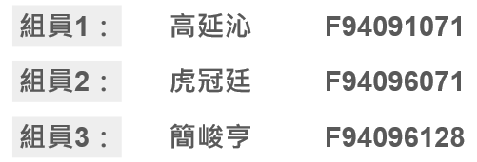
嵌入式系統 Final Project
主題: | 基於呼吸面罩的簡易呼吸器
組別: | Group 1

Slide 2
Outline
PART 1 | Introduction
PART 2 | Thinking Process
PART 3 | Design & Methodology
PART 4 | Demo Video
PART 5 | Future Improvement

Slide 3
PART 1 - Introduction

Slide 4

Introduction
A ventilator is used when a patient is unable to breathe on their own or when they’re able to breath but cannot achieve the required level of oxygen concentration in the body.
Principle of gas delivery:
Positive Pressure Ventilation
Negative Pressure Ventilation
High-Frequency Ventilation
What can it do？
Controlled the respiratory parameters such as respiratory rate and tidal volume through a microcomputer-based system that incorporates monitoring systems, alarm systems and respiratory self-assessment functions.

Slide 5
PART 2 – Thinking Process

Slide 6



First Discussion
Air Flow
How to generate
Control flow speed
Control breath frequency
Depend on physiological signal
Mask
How to connect with pump
3D printing
Arduino
Control system
Monitor physiological signal
GUI

Slide 7
Final Version
Air Flow
How to generate
Control flow speed
Control breath frequency
Depend on physiological signal
Mask
How to connect with pump
3D printing
Arduino
Control system
Monitor physiological signal
GUI

Slide 8
PART 3 – Design & Methodology

Slide 9
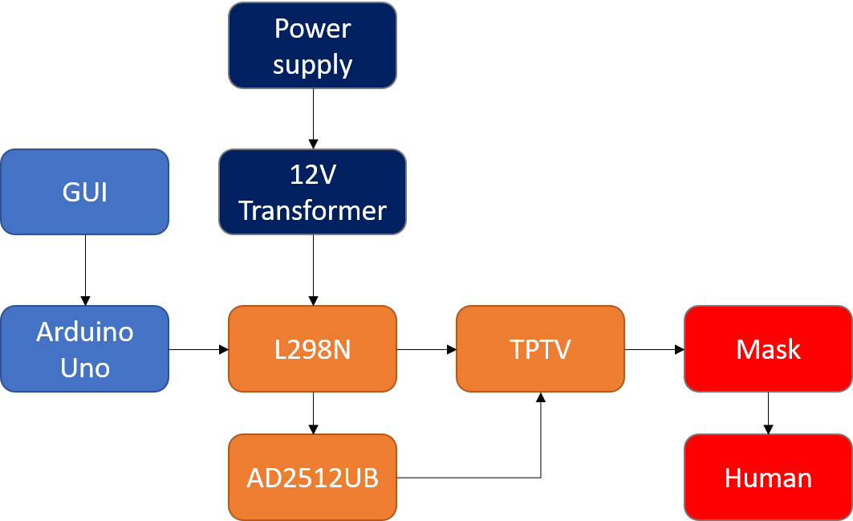
Block Diagram

Slide 10
Devices
Device | number
Arduino Uno | 1
AD2512UB | 1
Easy Breath Mask | 1
L298N | 1
TPTV | 1
Soft tube | several
Power transformer | 1

Slide 11
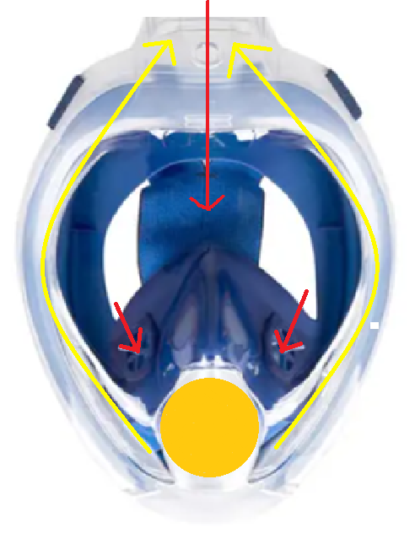
Influx of air
Mask Design
Purpose: To direct the airflow inside the mask towards the desired direction as shown in the diagram.
Adjusting the direction of the one-way valve inside the mask.
Closing certain exhaust ports.
gushing air
Sealed

Slide 12
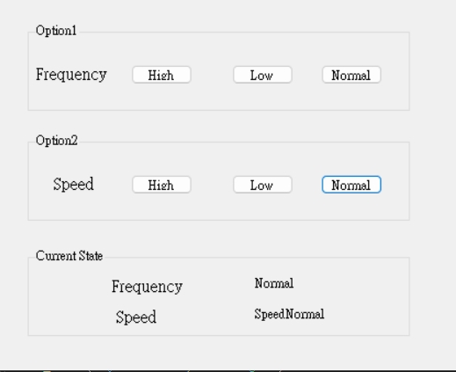
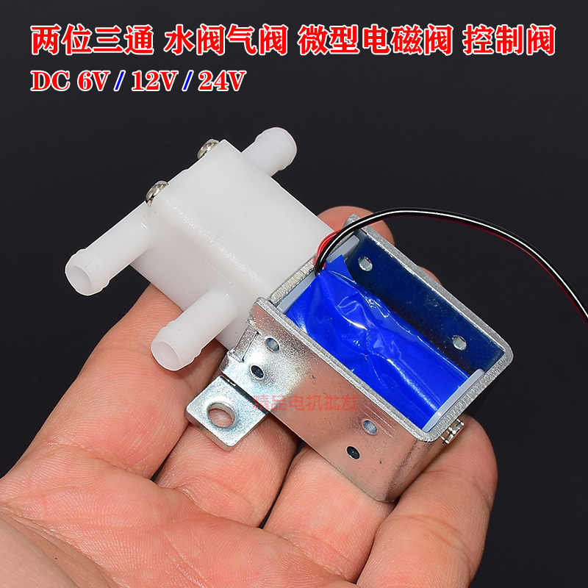
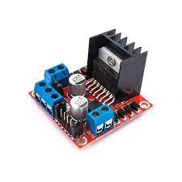
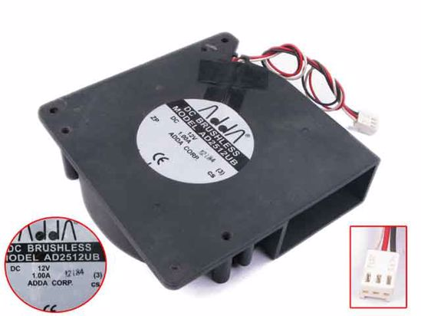

GUI & Control System
TPTV
Digital
Signal
Core
L298N
PWM
Signal
AD2512UB

Slide 13
PART 4 – Demo Video

Slide 14
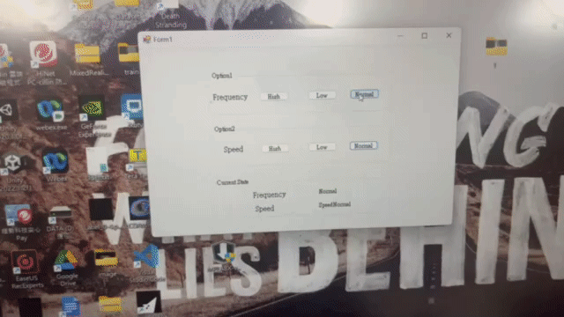
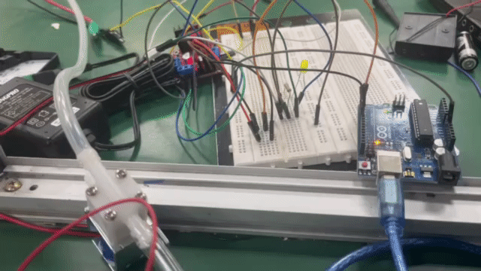
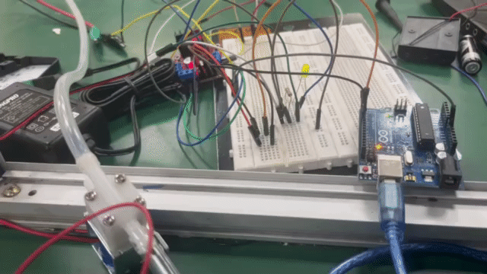
Frequency
LOW
NORMAL
HIGH

Slide 15
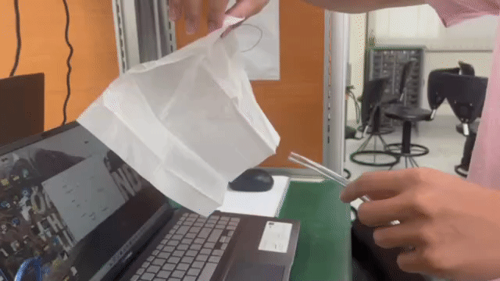
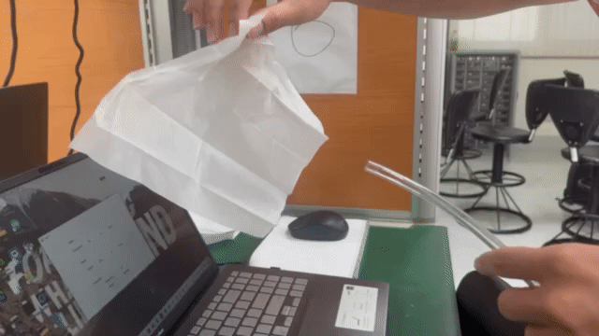
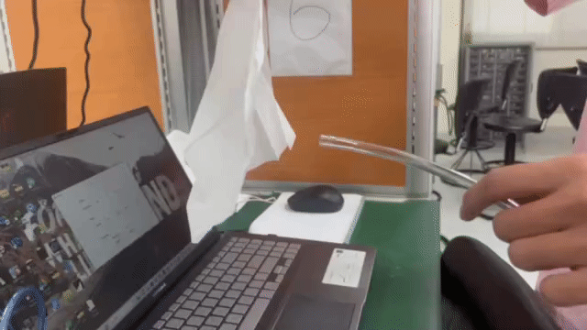
Speed
LOW
NORMAL
HIGH

Slide 16
PART 5 – Future Improvement

Slide 17
Improvement
Flow pressure is not enough for a ventilator
When L298N work on 2 channels, its voltage would drop 1.4V
Can improve the deliver of air flow

Slide 18
Thank you for your attention !

Slide 19
Reference
https://www.instructables.com/Gripper-Made-of-Soft-Muscles-With-Arduino-Code/
https://robu.in/wp-content/uploads/2017/12/L298N-Module-Pinouts-ROBU.IN_.pdf
http://cht.a-hospital.com/w/%E7%AE%80%E6%98%93%E5%91%BC%E5%90%B8%E6%9C%BA
https://landing.coolermaster.com/faq/3-pin-and-4-pin-fan-wire-diagrams/

